Slide 1
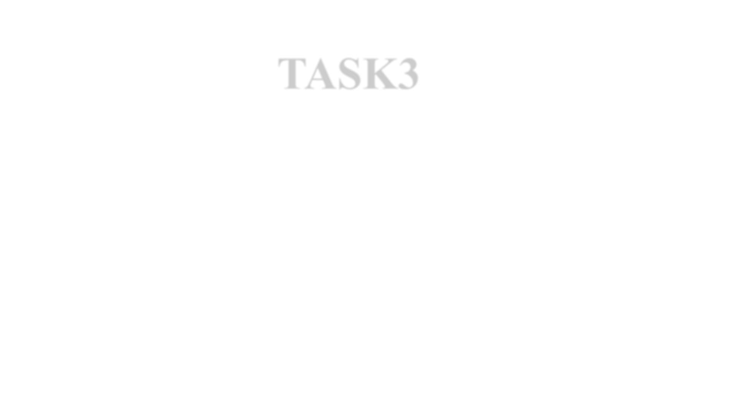
TASK3
AIM:- ENTERING/SOLVING A GIVEN WEBSITE USING BURPSUITE.
STEPS:-
STEP 1:OPEN VMWARE WORKSTATION AND LOGIN TO KALI LINUX
STEP 2: OPEN BURP SUITE CHECK WHETHER THE INTERCEPT IS ON .
STEP 3:OPEN FIREFOR AND SEARCH FOR VULNWEB.
STEP 4: CLICK ON http://testasp.vulnweb.comthe given interface will be opened.
STEP 5: CLICK ON SEARCH BAR AND CLICK THE FOXYPROXY ON.
STEP 6: TRY TO ENTER ONE OF THE PAYLOADS SO THE REQUEST WILL BE SENT TO BURPSUITE.
STEP 7: AFTER THE REQUEST COMES SEND IT TO INTRUDER AND FORWARD THE REQUEST AND ADD THE PAYLOAD
POSITION ONLY FOR THE REQUIRED PLACE.
STEP 8: ADD THE XSS PAYLOADS ,WHICH CAN BE DOWNLOADED FROM www.github.com.
STEP 9: START THE ATTACK AND CHECK WHETHER THERE IS SUDDEN CHANGE IN LENGTH AND STATUS.
STEP 10:COPY THE URL TO SHOW THE RESPONSE FOR THE PAYLOD THAT HAS BEEN ACCEPTED .
STEP 11:COPY THE URL AND SEARCH IT IN FIREFOX .

Slide 2

OUTPUT

Slide 3
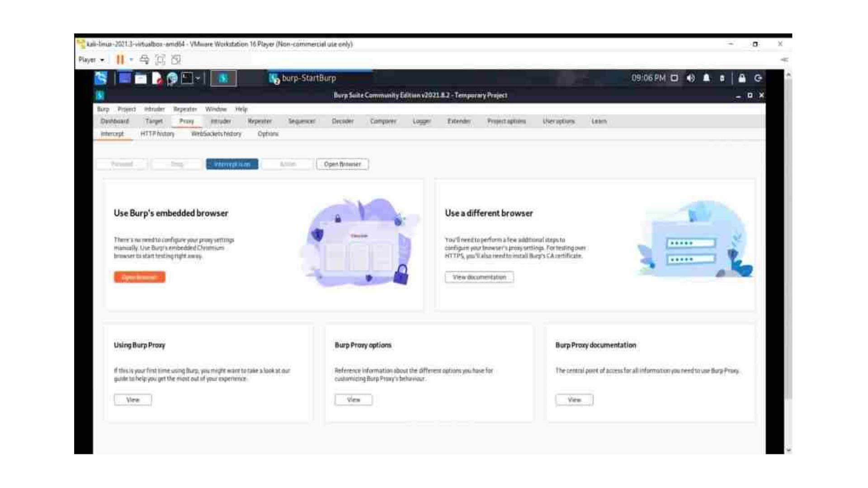

Slide 4
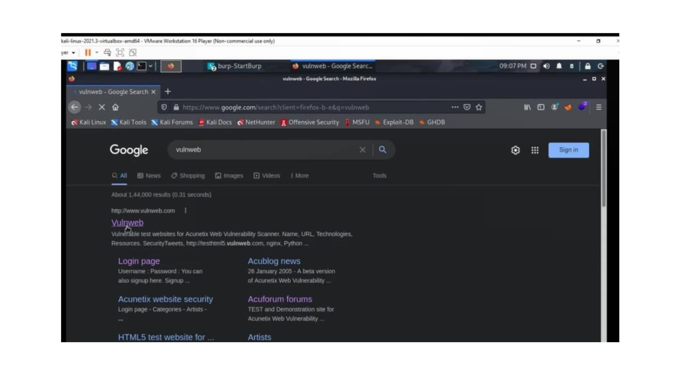

Slide 5
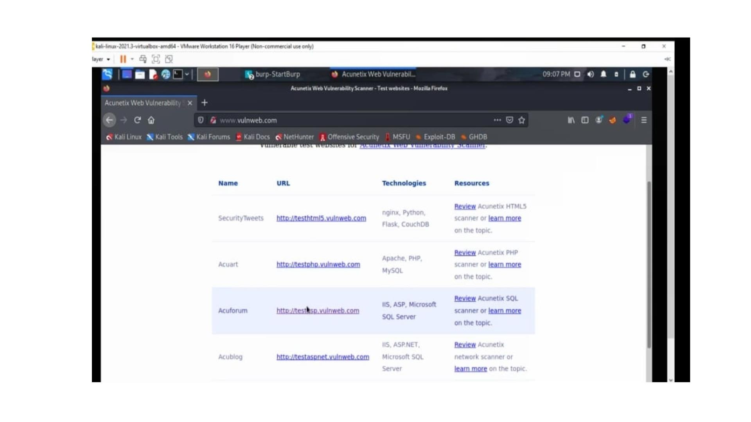

Slide 6
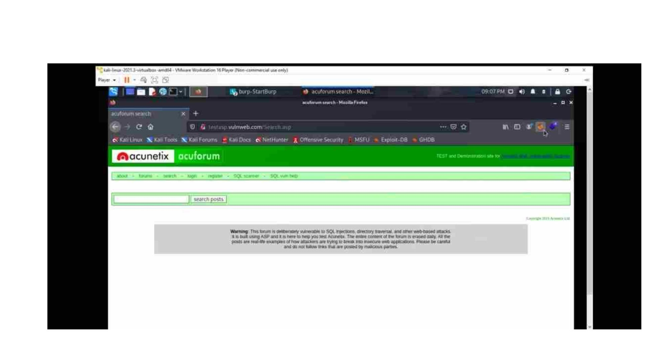

Slide 7
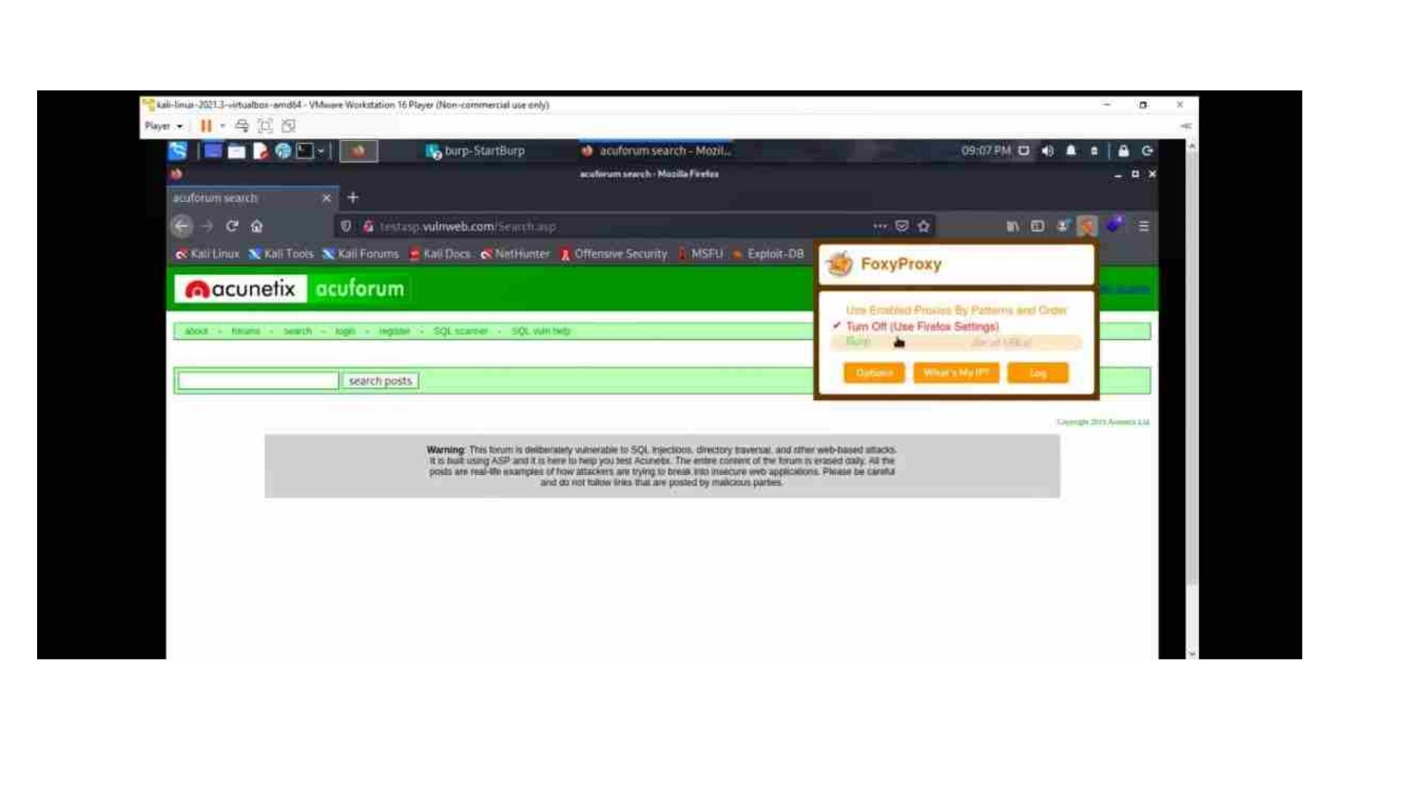

Slide 8
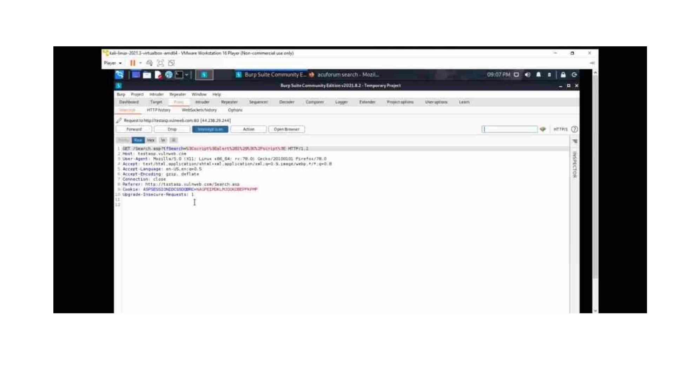

Slide 9
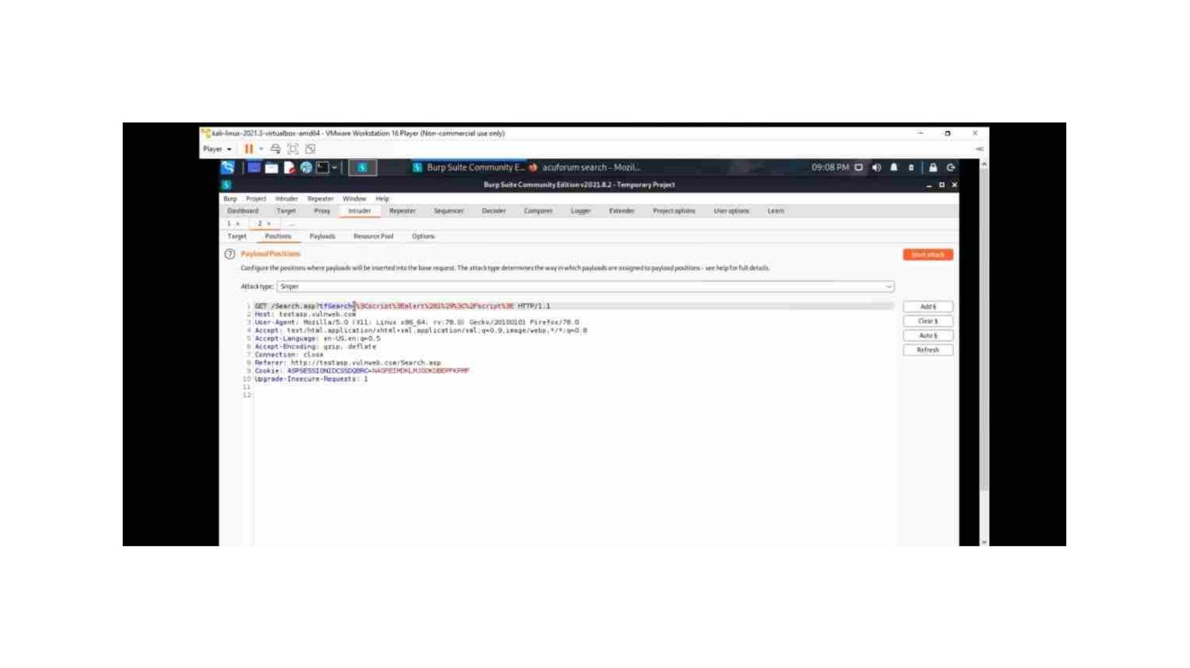

Slide 10
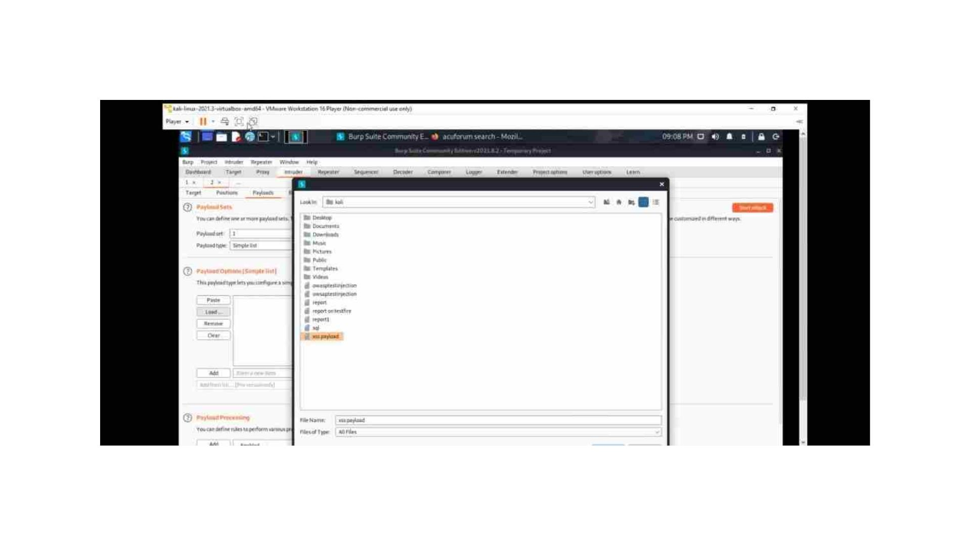

Slide 11
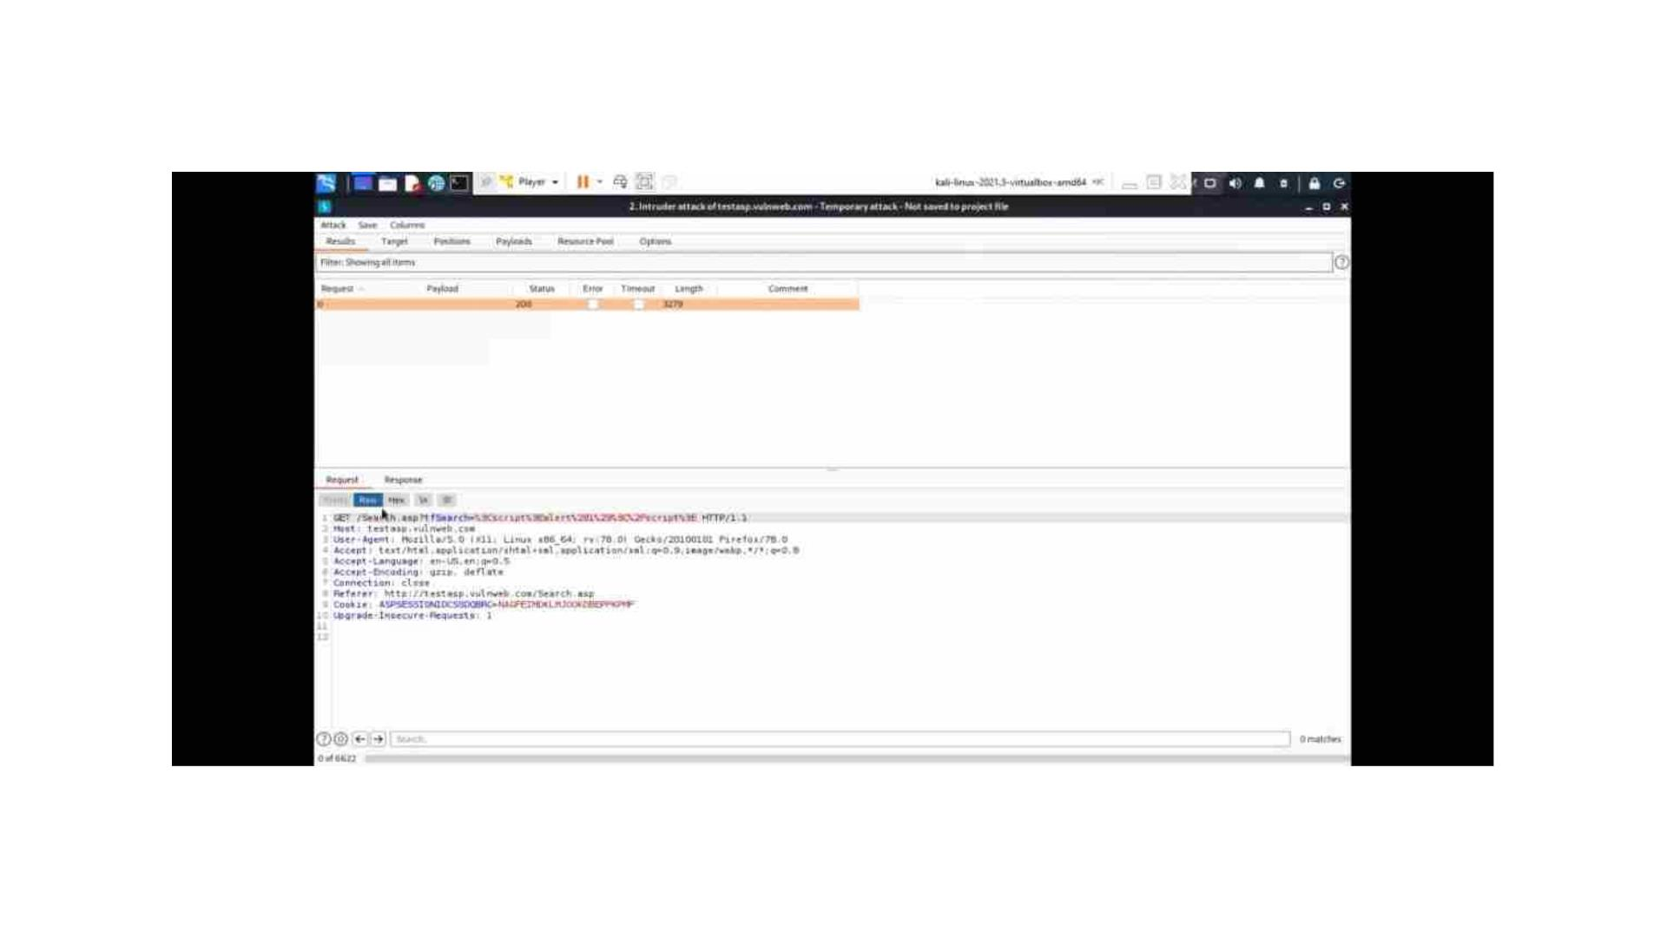

Slide 12
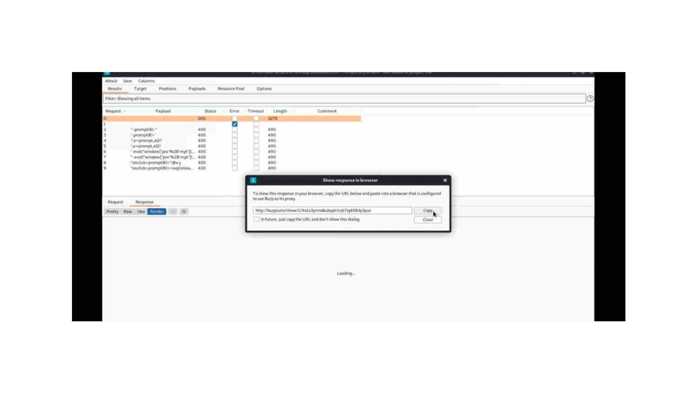

Slide 13
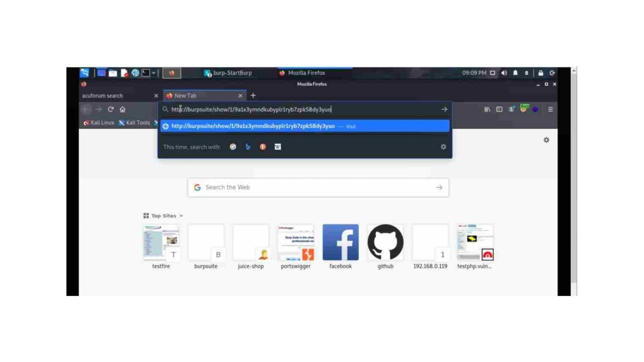

Slide 14
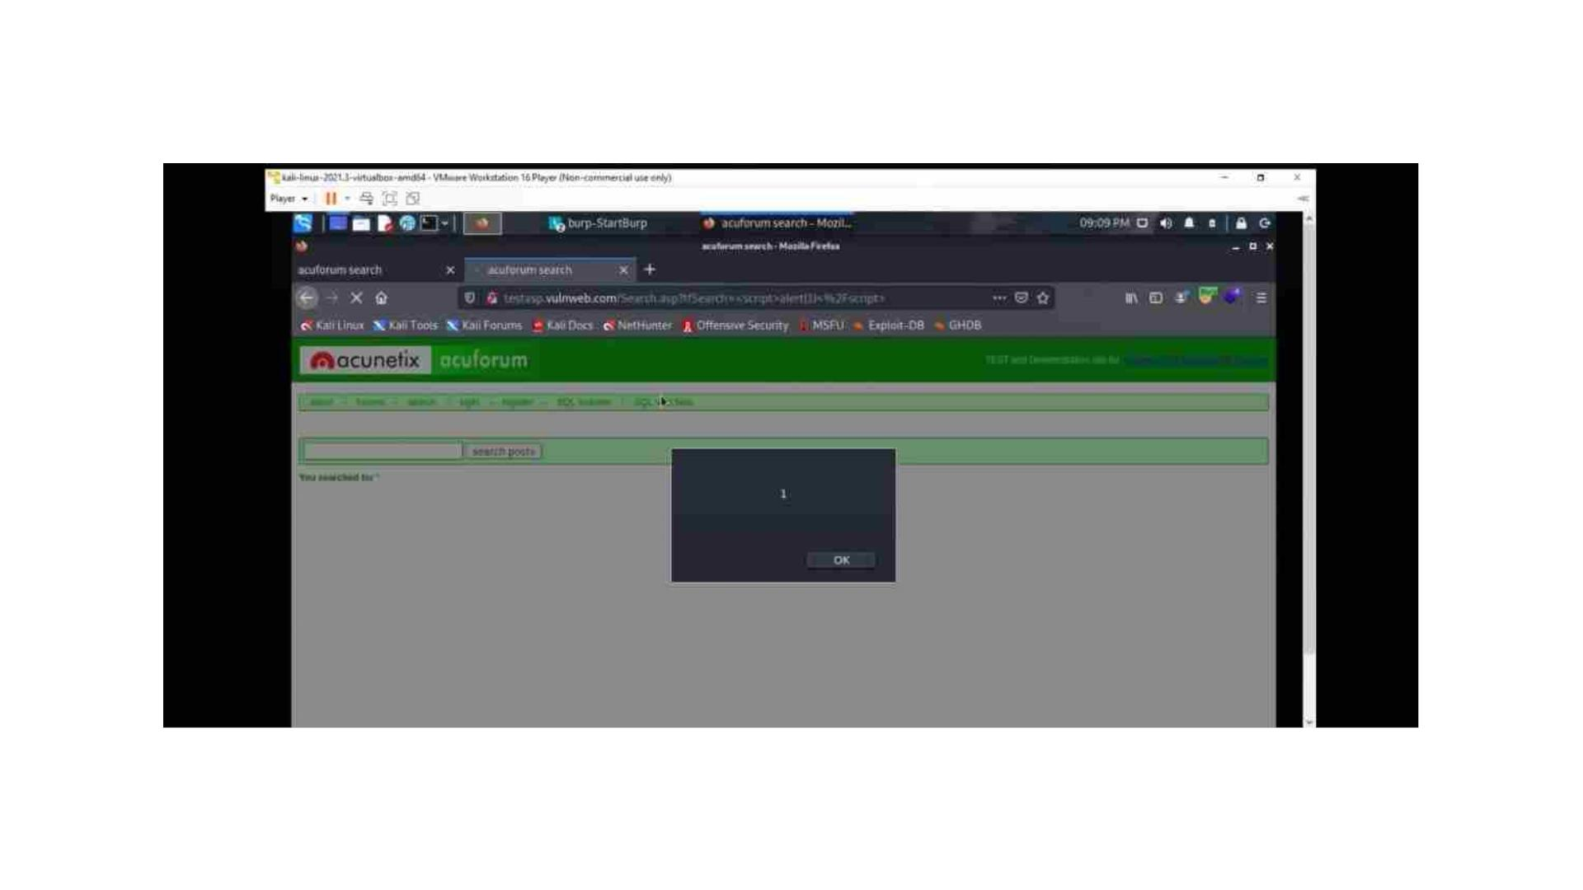

Slide 15
